Slide 1
Analyzing the Impact of Lifestyle Factors on Sleep Quality and Health
Manikanta Pudoka
Varshitha Mullangi
Joshitha Dandlamudi
Tejaswini Pallepati
Fazaluddin Mohd

Slide 2
TABLE OF CONTENTS:
1.DATA DESCRIPTION
2.DATA ATTRIBUTES
3.SCATTER PLOT OF ALL FEATURES
4.SELECTED FEATURES
5.PLOTS
6.EDA
7.CONFUSION MATRIX
8.COEFFICIENTS OF LINEAR REG
9.KNN & NB

Slide 3
DATA DESCRIPTION:
This project utilizes the Sleep Health and Lifestyle Dataset from Kaggle, which contains information about individuals' sleep patterns, lifestyle choices, and health indicators.
Source: Kaggle (https://www.kaggle.com/datasets/uom190346a/sleep-health-and-lifestyle-dataset)
The dataset comprises records of individuals' sleep health and lifestyle factors. It includes various sleep-related metrics, daily habits, and health indicators that can potentially influence sleep quality and overall well-being.

Slide 4
DATA ATTRIBUTES:
BMI:This column contains the body mass index (BMI) category of the individuals, classified as:Normal,overweight and Obese.
Gender: It contains the gender of the individuals
Quality of sleep:A Subjective rating of sleep quality(Scale:1-10)
Heart Rate:It represents the number of heartbeats per minute (BPM)
Physical activity level:A rating of physical activity (Scale:1-100)
sleep disorder:mentioning the disorder types

Slide 5
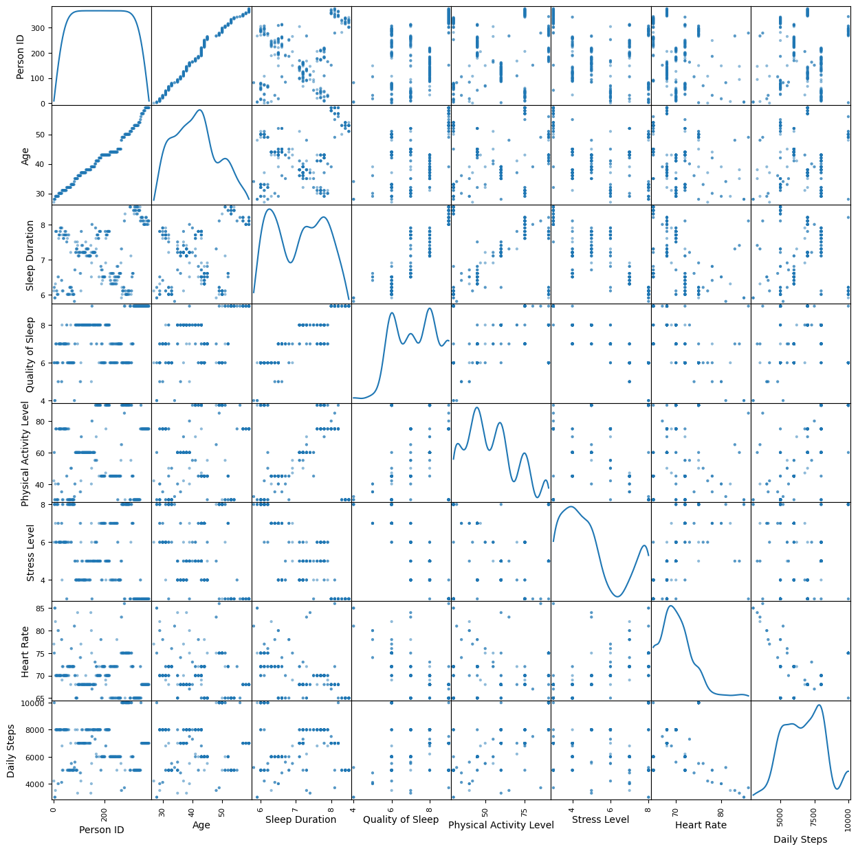
SCATTER PLOT OF ALL FEATURES:
Strong Positive Correlations: Physical Activity Level & Daily Steps, Quality of Sleep & Sleep Duration.
Moderate Negative Correlations: Stress Level with Quality of Sleep & Physical Activity.
Weak/No Correlations: Age and Person ID with most other variables.
Key Observations: More physical activity increases steps; better sleep quality is linked to longer sleep; higher stress reduces sleep quality and physical activity.
Potential Insights: Promoting physical activity and stress reduction may improve health metrics; sleep quality and duration are closely linked.

Slide 6
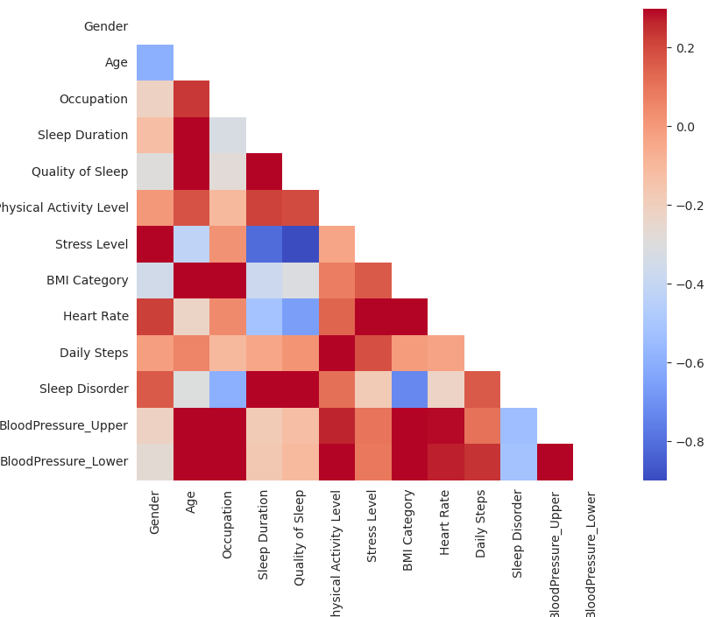
SELECTED FEATURES:
Positive Correlations:
Sleep Duration and Quality of Sleep: These two features appear to be positively correlated. This suggests that longer sleep duration tends to be associated with better sleep quality.
Daily Steps and Physical Activity Level: There is a strong positive correlation, which makes sense, as a higher number of daily steps likely reflects higher physical activity levels.
BloodPressure_Upper and BloodPressure_Lower: These two measures of blood pressure are also highly positively correlated, as expected.

Slide 7
Negative Correlations:
Stress Level and Quality of Sleep: These two variables show a strong negative correlation, indicating that higher stress levels are associated with poorer sleep quality.
Stress Level and Sleep Duration: There's a negative relationship between these variables, suggesting that higher stress might reduce sleep duration.
Feature Selection Strategy:
Variables to be selected :
Sleep Duration (positive correlation with Quality of Sleep)
Stress Level (negative correlation with Quality of Sleep)
Understanding how sleep duration and quality interact with stress and other factors can be critical in health, productivity, and lifestyle analysis.Along with the demographics features these can be selected.

Slide 8
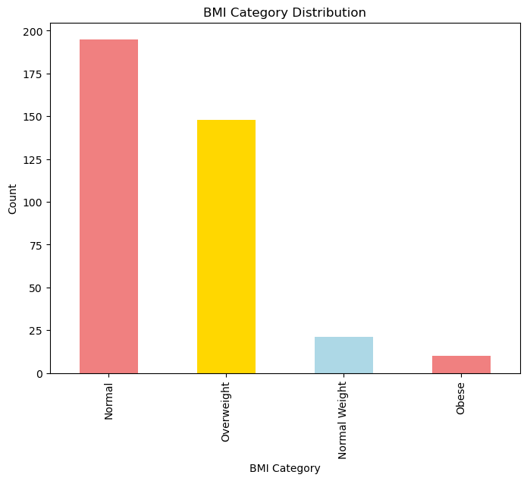
BAR CHART:
BMI CATEGORY: The population has a healthy weight distribution, with the majority in the Normal BMI category (195 individuals), followed by Overweight (150). The Normal Weight and Obese categories are smaller, with 25 and 10 individuals, respectively. There may be a need for weight management interventions for the Overweight group.

Slide 9
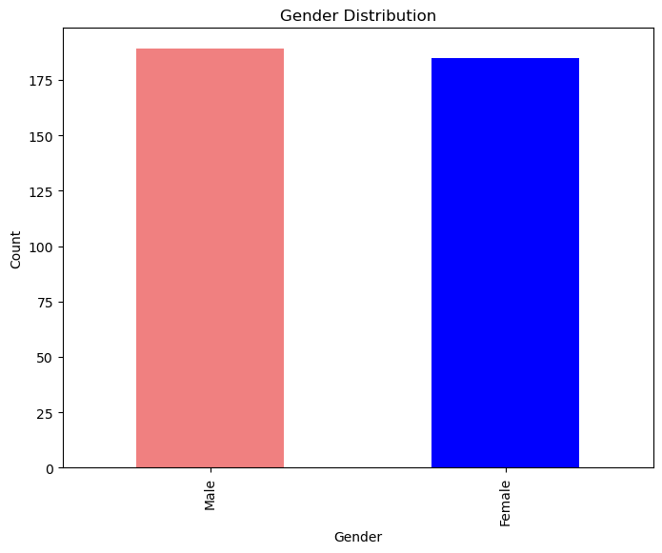
GENDER:The distribution between males and females is very close to equal.
There is a slightly higher number of males than females, but the difference is minimal.
The y-axis (Count) starts at 0 and goes up to about 200, giving a clear representation of the actual numbers.

Slide 10
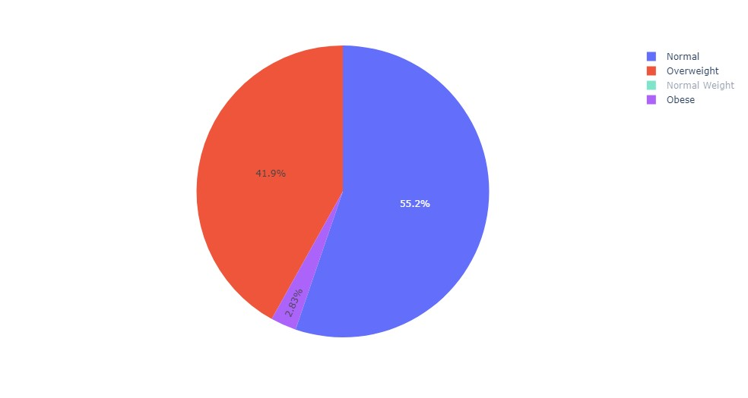
PIE CHART:
BMI CATEGORY:Over half the population falls in the Normal BMI category
Nearly 42% are classified as Overweight
Combined Normal and Normal Weight categories make up 57.5%
Obesity rate is very low at 0.6%

Slide 11
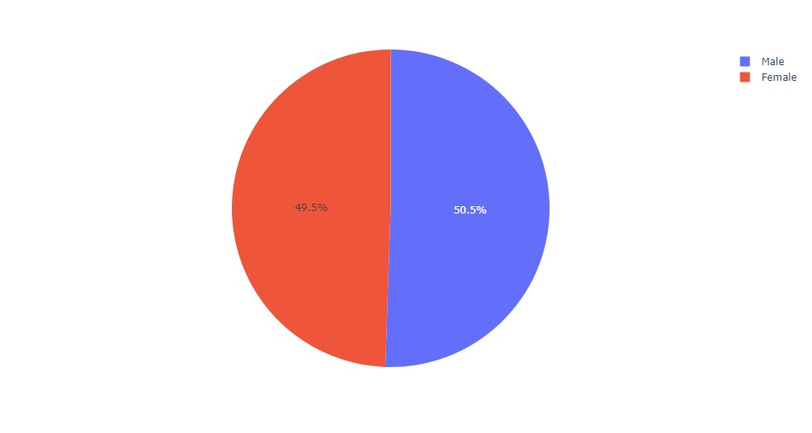
GENDER:
Nearly equal distribution between males and females
Slight male majority, but difference is minimal (1%)

Slide 12
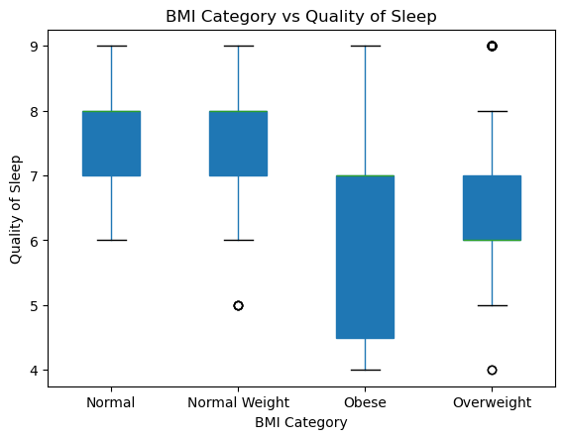
BOX PLOT:
Median: Normal and Normal Weight categories have the highest sleep quality (7.5-8), while Obese has the lowest (5.5-6).
Spread: Obese category shows the largest variability in sleep quality, followed by Overweight.
Range: Obese category spans the widest range (4-9), while others range from 6 to 9.
Outliers: Outliers are present in the Normal Weight and Overweight categories.
Overall Trend: Sleep quality decreases as BMI increases, with more variability in higher BMI categories.
Skewness: Overweight is slightly skewed towards lower sleep quality, while Obese shows slight skew towards higher values.

Slide 13
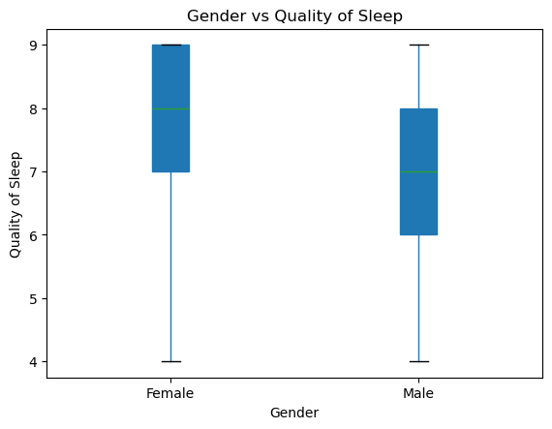
Median: Females have a higher median sleep quality (8) than males (7).
Spread: Female sleep quality is more consistent with a smaller interquartile range.
Range: Both genders have similar overall ranges, from 4 to 9.
Skewness: Female data is skewed towards lower values, while male data is more symmetrical.
Outliers: No visible outliers for either gender.
Overall Comparison: Females report slightly higher and more consistent sleep quality, while males show more variability

Slide 14
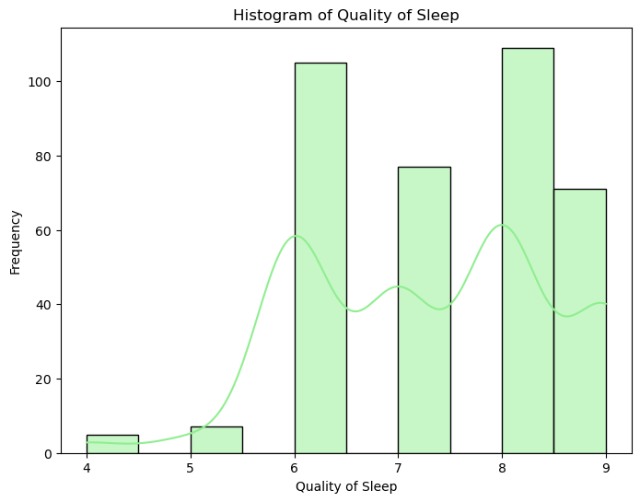
HISTOGRAM:
Range: Sleep quality is rated from 4 to 9.
Distribution: Multimodal with two peaks at 6 and 8, slightly right-skewed.
Peaks: Most common ratings are 6 and 8, followed by 7.
Frequency: Highest frequencies at 100-110 for 6 and 8 ratings.
Low/High Ratings: Few report poor sleep (4-5), while many report good sleep (8-9).
Overall: Most people experience average to good sleep quality, with no clear outliers.

Slide 15
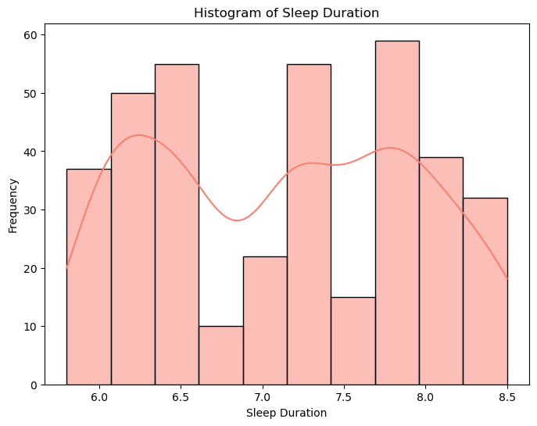
Most individuals sleep between 6.5 and 8.0 hours, with many meeting the recommended 7-9 hours. Some have shorter (6.0-6.5) or longer (8.0-8.5) sleep durations, indicating variability in sleep patterns. There's a noticeable dip in frequency around 7.0 hours. While most people fall within the healthy sleep range, subgroups may have sleep deficiencies or excess.

Slide 16
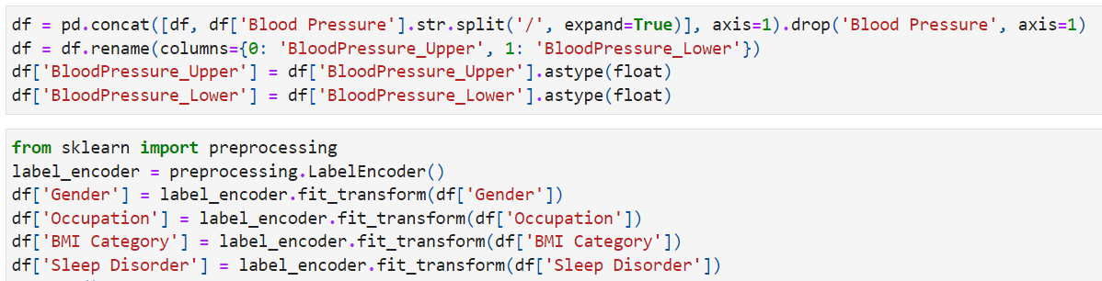
EDA
Data Preprocessing:
*The 'Blood Pressure' column is split into two new columns using string manipulation and are converted into the float type.
*Categorical features are converted into numeric values using Label encoder

Slide 17
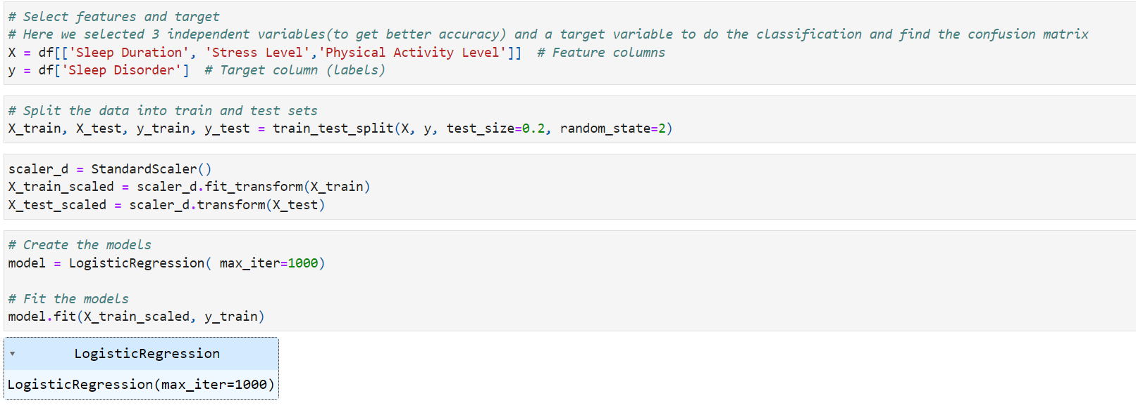
Logistic Regression

Slide 18
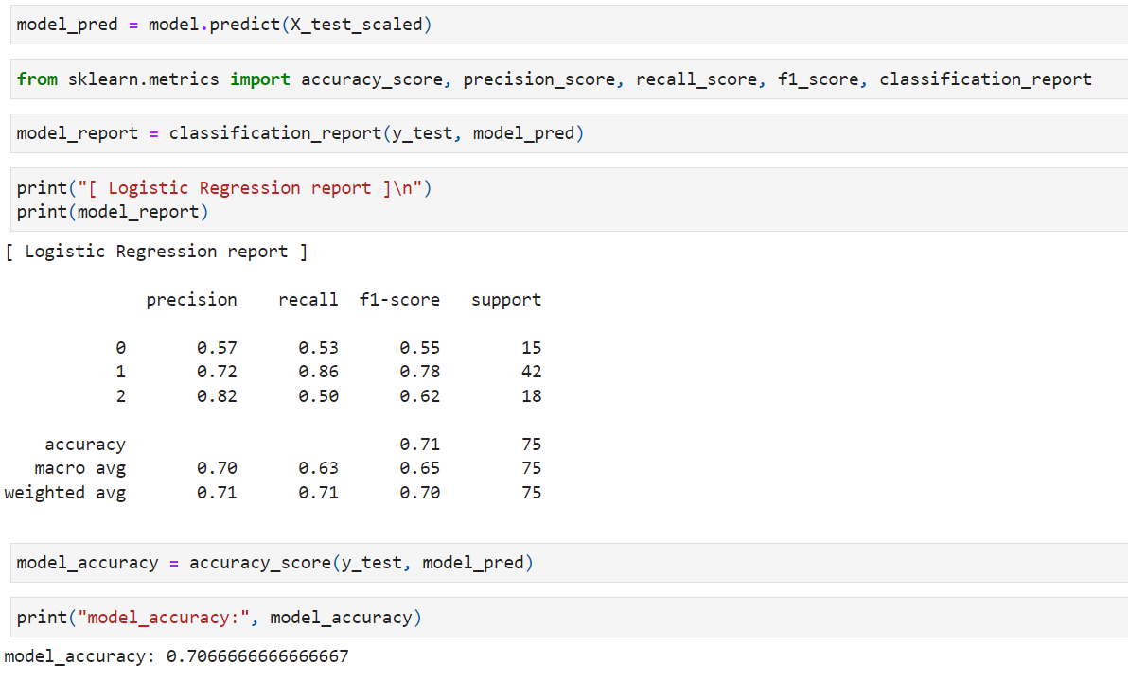

Slide 19
Results
Overall Accuracy: 71%
Class Precision/Recall (Sleep Apnea, Insomnia, None):
Sleep Apnea (Class 1) has high recall, indicating it correctly identifies most cases of Sleep Apnea.
Insomnia (Class 2) has decent precision, but lower recall, meaning some cases of Insomnia are misclassified.
None (Class 0) has lower precision, with more misclassifications into other classes.

Slide 20
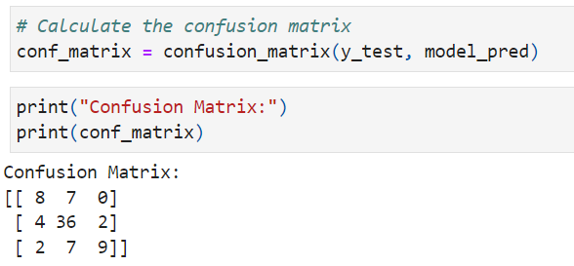
Confusion Matrix

Slide 21
Interpretation
Class 0 (None): The model is struggling with classifying "None" correctly, as there are 7 false negatives where "None" was predicted as "Sleep Apnea."
Class 1 (Sleep Apnea): The model performs well at identifying Sleep Apnea, with 36 correct predictions and relatively fewer misclassifications compared to the other classes.
Class 2 (Insomnia): The model has some trouble distinguishing between "Insomnia" and "Sleep Apnea", as 7 cases of "Insomnia" were incorrectly predicted as "Sleep Apnea."
There are significant false negatives for the "None" class, leading to misclassification as "Sleep Apnea."
"Insomnia" is frequently confused with "Sleep Apnea," indicating a challenge in differentiation between these two classes by the model.

Slide 22
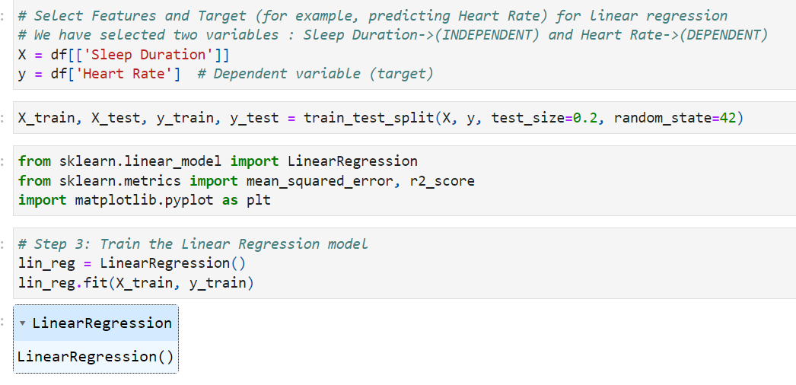
Linear Regression

Slide 23
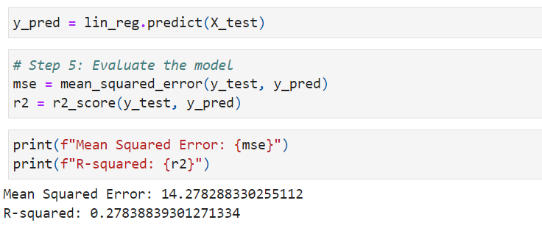
MSE and R-Squared

Slide 24
Interpretation
The MSE value of 14.28 means that, on average, the squared difference between your predicted sleep outcomes (e.g., sleep disorder, sleep quality) and the actual outcomes is about 14.28 units.
If you're predicting something like sleep quality, this means the predictions deviate from actual values by a substantial margin, leading to prediction errors.
The R² value of 0.278 means that only 27.8% of the variability in the target variable (such as sleep disorder or quality) is explained by the features in the model (e.g., sleep duration, stress level, physical activity).
This low R² indicates that your model is not capturing most of the factors that contribute to variability in the sleep outcome. The remaining 72.2% of variability is unexplained, implying that other factors, which are not included in the model, might play a significant role.

Slide 25
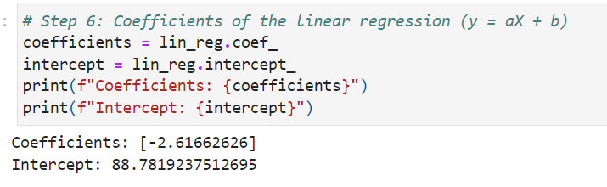
Coefficients of Linear regression
The full regression equation based on your coefficients and intercept is:
y=−2.62X+88.78

Slide 26
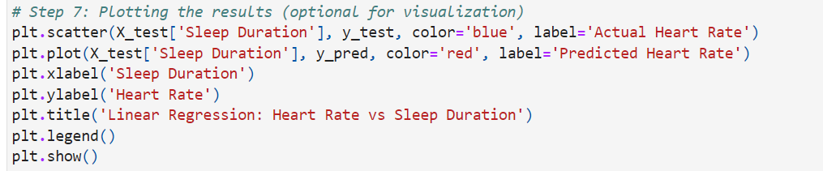
Visualization

Slide 27
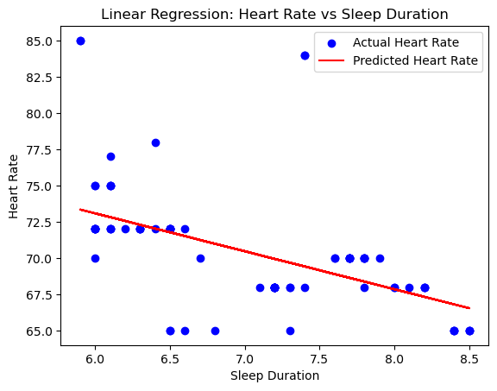

Slide 28
Interpretation
The red line slopes downward, indicating a negative relationship between sleep duration and heart rate. This suggests that as sleep duration increases, the predicted heart rate decreases slightly.
The model captures the general negative trend between sleep duration and heart rate.
But the scatter of data points suggests that the linear model is not a perfect fit for predicting heart rate based on sleep duration alone.
The linear regression suggests that longer sleep is associated with lower heart rate, but the scatter in actual values suggests that other factors contribute to heart rate variability, making sleep duration just one part of the equation.

Slide 29
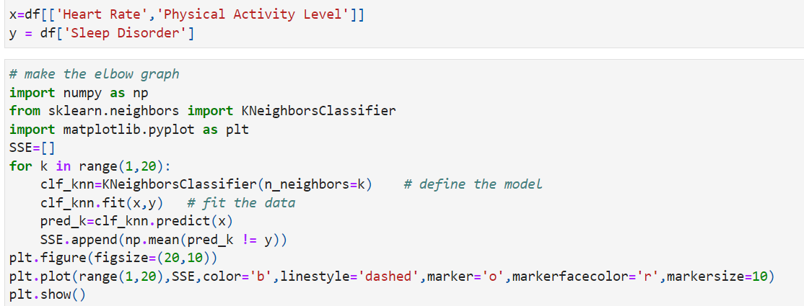
KNN (K-Nearest Neighbour)

Slide 30
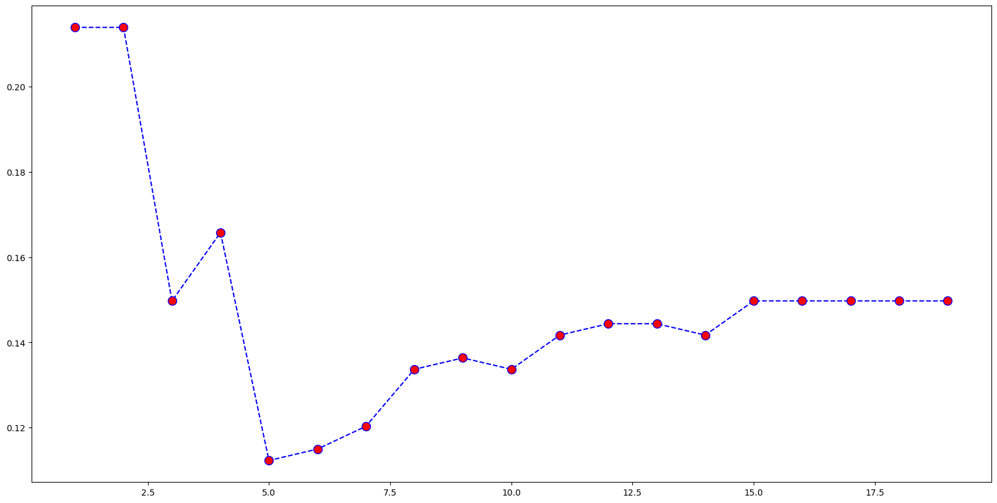
From the plot , K=5.It shows a sharp drop from k = 1 to k = 5, and after k = 5, the slope starts to flatten out.
This is called the Elbow point.
based on the shape of this curve, k = 5 seems to be the optimal value.

Slide 31
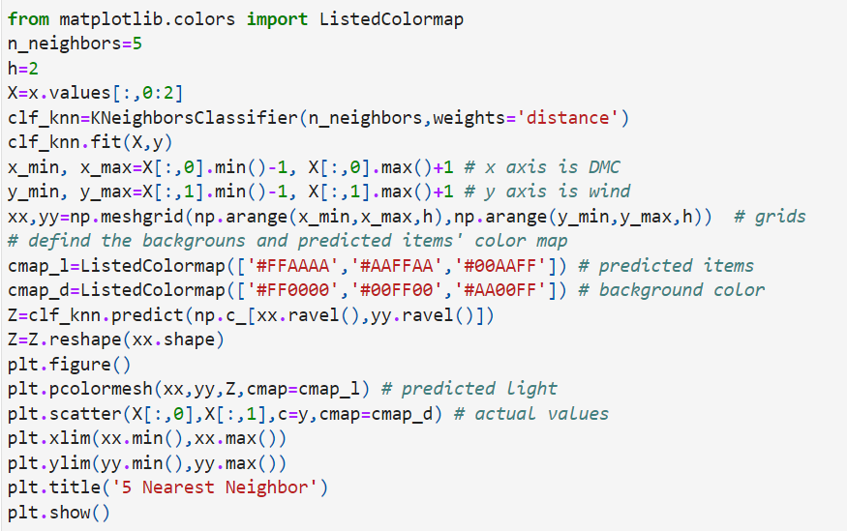

Slide 32
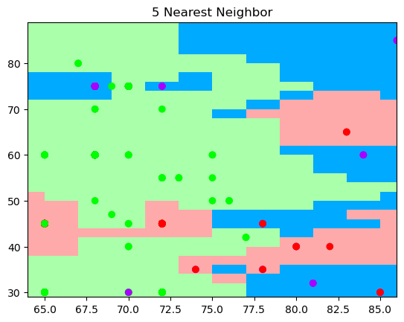
KNN plot

Slide 33
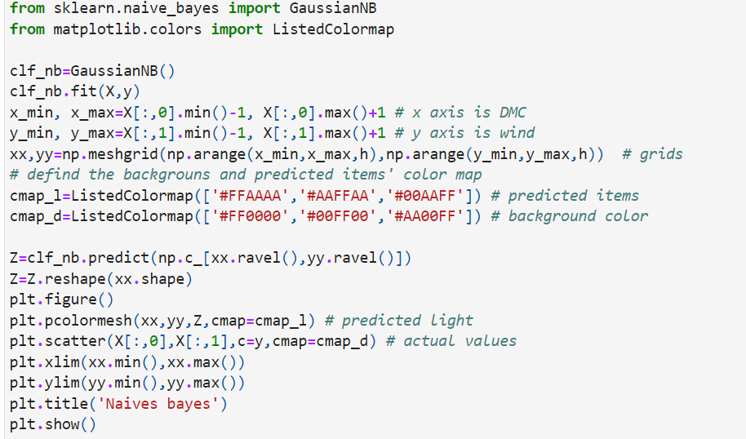
NB (Naive Bayes)

Slide 34
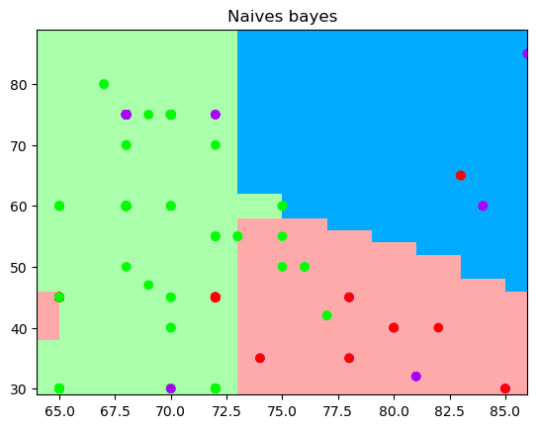

Slide 35
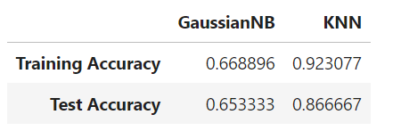
Accuracies

Slide 36
Gaussian Naive Bayes:
Moderate accuracy: Naive Bayes has testing and training accuracies that fall between 60 and 70 percent. The model does rather well on both the training and test data, as evidenced by this modest degree of accuracy. The Naive Bayes model appears to generalize reasonably well, meaning it does not overfit to the training data, as indicated by the narrow difference between the training accuracy (66.89%) and testing accuracy (65.33%). It works similarly with test data that isn't visible.

Slide 37
K-Nearest Neighbors (KNN):
High training accuracy: On the training set, the KNN model achieves a very high accuracy of 92.31%. This implies that a large portion of the training data's complexity and patterns are being captured by KNN. Test accuracy slightly declines: KNN's test accuracy of 86.67% is still high but lower than the training accuracy. The model may be learning some patterns in the training data that don't transfer as well to the test set, which could be the cause of the KNN's test accuracy being marginally lower than its training accuracy. However, this overfitting isn't severe because the test accuracy is still fairly high.

Slide 38
What model works better?
Gaussian NB:This model has moderate accuracy and appears to generalize fairly well.
KNN has higher accuracy but shows signs of potential overfitting.
In general, KNN is performing better in terms of accuracy compared to Naive Bayes, but it may come at the cost of some overfitting, while Naive Bayes provides a more balanced, though less accurate, model.Based on the accuracies KNN is the best model.

Slide 39

SVM & KERNELS
Selecting 2 training and 1 target variables:
Heart Rate and Physical Activity Level as training features and Sleep Disorder as target column

Slide 40
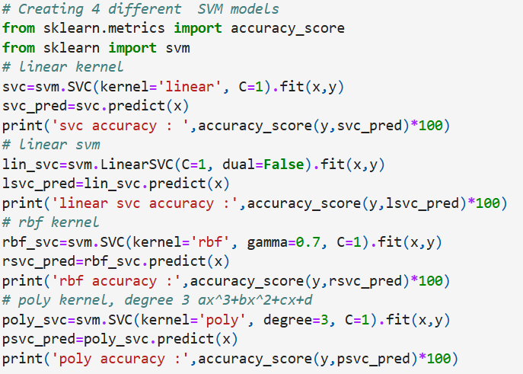
SVM models

Slide 41
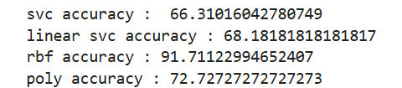
Accuracies:

Slide 42
Interpretation for accuracies
Linear SVM (66.31% Accuracy)
Limited performance with a simple linear boundary.
Linear relationship does not sufficiently capture data patterns.
LinearSVC (68.18% Accuracy)
Slightly better than Linear SVM but still limited.
Not suited for complex data patterns.
RBF SVM (91.71% Accuracy)
Significantly higher accuracy with a non-linear boundary.
Captures complex relationships effectively.
Best-performing model for this dataset.
Polynomial SVM (72.73% Accuracy)
Better than linear models but less effective than RBF.
Some non-linear relationships captured, but limited flexibility.

Slide 43
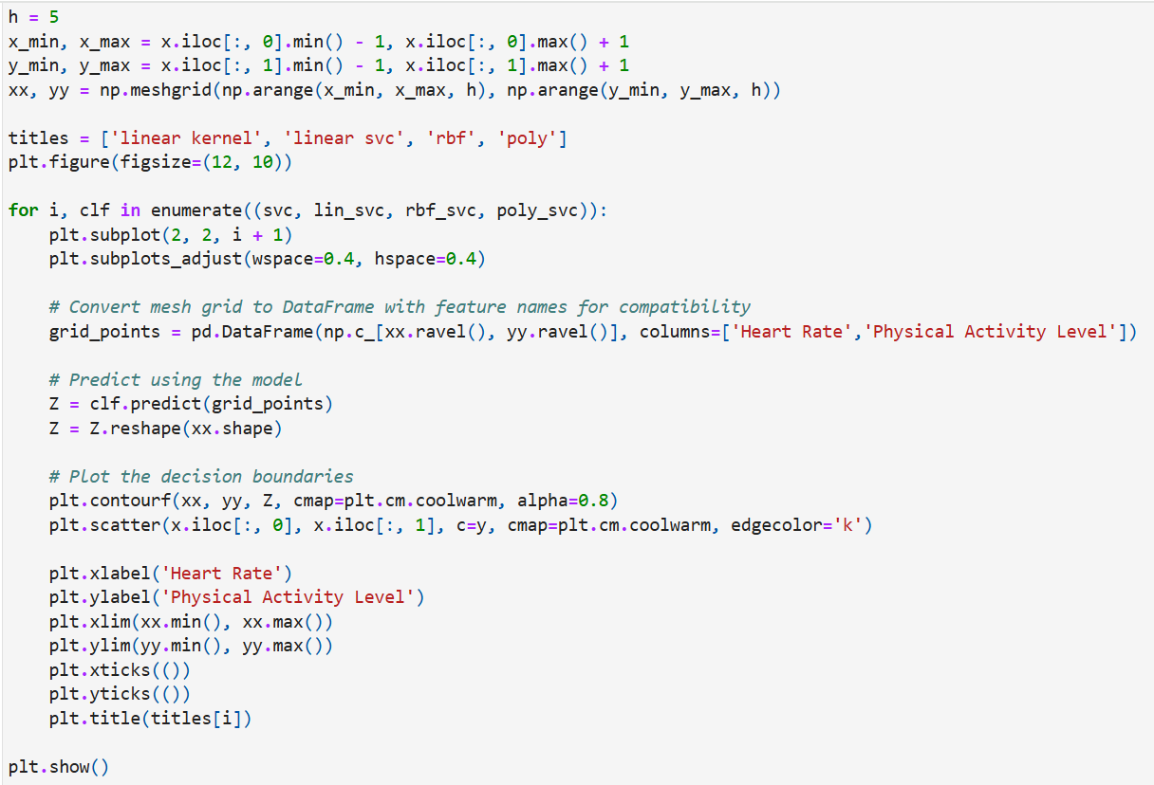
Kernels

Slide 44
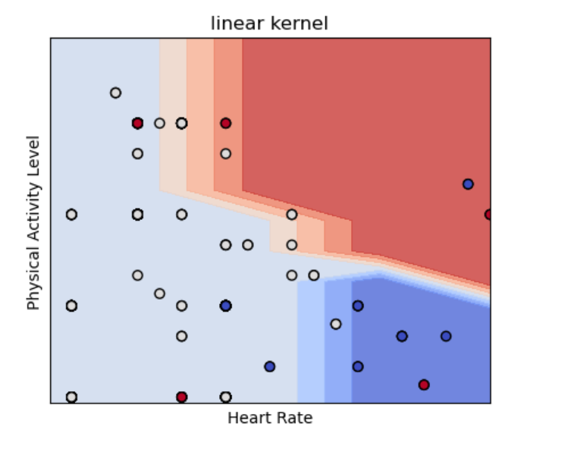
Linear kernel
A straight-line decision boundary shows limited flexibility, dividing the space into two primary regions (light blue and red).
Misclassifications indicate it struggles to capture the actual data patterns, and its low accuracy highlights difficulty in handling non-linear relationships.

Slide 45
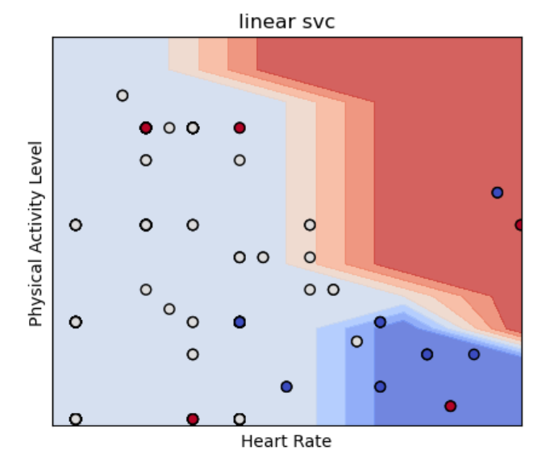
Linear SVC
A similar straight-line boundary with slight differences in positioning.
Misclassifications occur due to limited ability to handle complex patterns. While accuracy is slightly better than the linear kernel, it remains constrained by its linear nature.

Slide 46
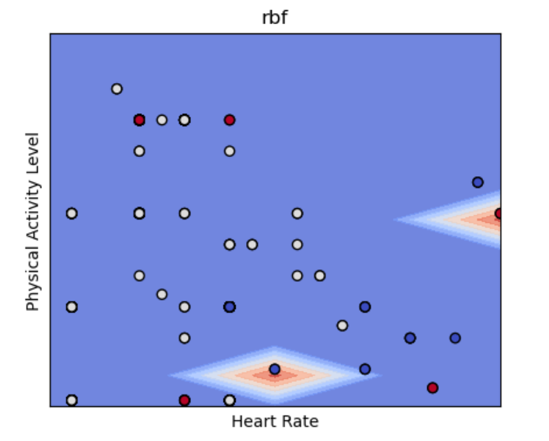
Rbf
A complex, non-linear decision boundary with "islands" or "pockets" that effectively separates clusters and minimizes misclassification.
The high accuracy reflects a strong capacity to capture intricate data patterns.

Slide 47
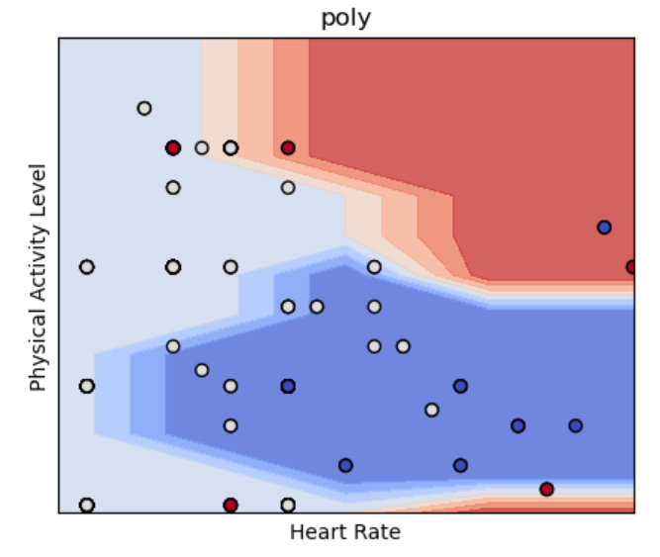
Poly
A non-linear boundary with defined curvature, providing better separation than linear models but less adaptability than RBF.
Shows moderate performance, capturing some non-linearity, though less effectively than RBF.

Slide 48
Best Performing Model:
RBF Kernel has the maximum accuracy because of its ability to capture complicated, non-linear interactions. Perfect for datasets with complex patterns that are too complex for linear models to handle. Limitations of Linear Models Low accuracy results from the straight-line boundaries produced by both linear kernel and linear SVC. Poor classification performance is the outcome of an inability to adjust to non-linear patterns. Perspectives on Polynomial Kernels offers some non-linear flexibility as a compromise. surpasses linear models in performance but falls short of the RBF kernel efficacy. Suggestion The RBF kernel is the suggested option for the best classification of data according to Age and Medication.

Slide 49
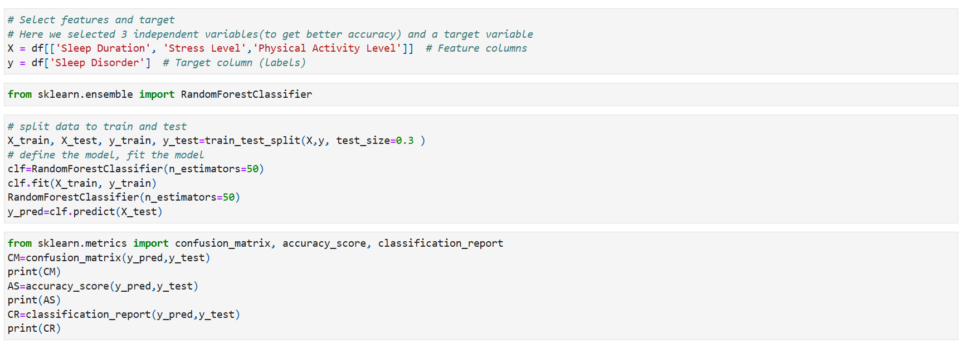
RANDOM FOREST

Slide 50
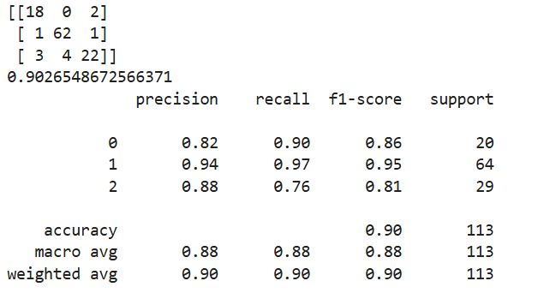
Output:

Slide 51
Interpretation:
The model scored an exceptional overall accuracy of 90.27%, with particularly strong performance in Class 1, which displayed both high precision (94%), and recall (97%). Class 0 likewise produced good results, with a precision of 82% and a recall of 90%. Class 2, while still good with 88% precision, trailed somewhat in recall at 76%, indicating room for growth. The model's effectiveness implies that, while it excels at detecting Class 1, improvements might be made to better distinguish Class 2, either by further tuning of model parameters or feature refinement to better discriminate between the classes.

Slide 52
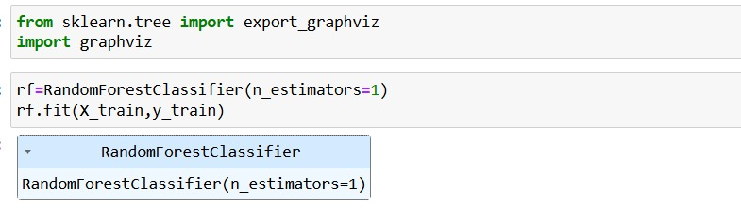
Random forest

Slide 53
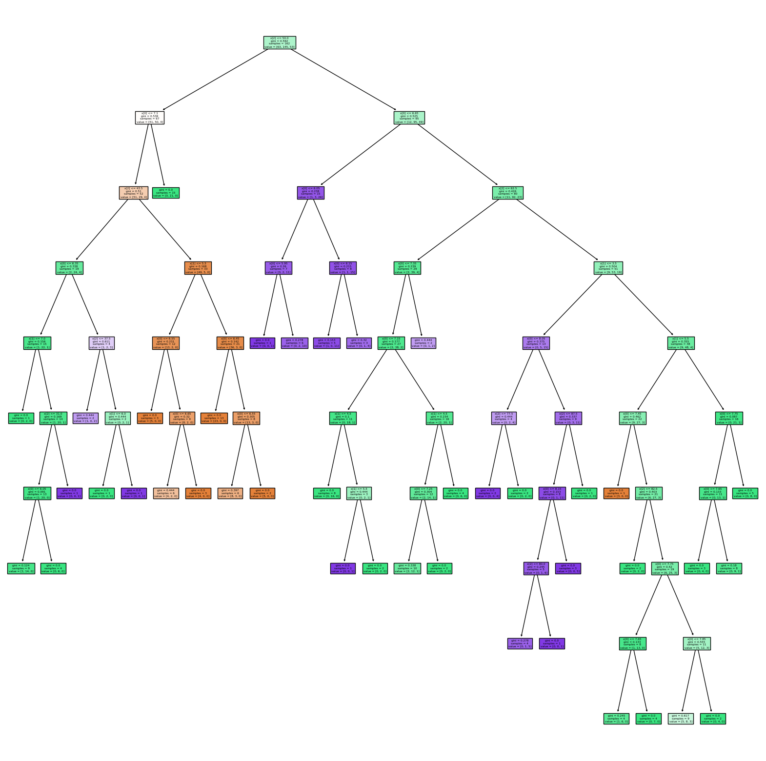
Random forest tree:

